Slide 1



JJSM’S INVENTORIA
Team Members: Jordan Artzy-McCendie, Sarah Caron-Dadoun,
Jerwinson-Flores Cunanan, Mohammad Khajavigodellou

Slide 2
Project Overview
• An Android Java-based inventory management system.
• Integrated with Firebase for real-time database and authentication.
• Designed for Admins and Employees.
• Supports product search, management.

Slide 3
Functional Specifications
• Authentication: Login, Registration, Forgot Password.
• Product Management: Search, View.
• Admin Controls: Monitor & delete products, manage user activities.
• Inventory Management: Add, edit, delete items.

Slide 4





Kanban
Why did we use kanban and trello?

Slide 5
User Types & Permissions
• Admins: Full access, manage inventory, employees.
• Employees: View, add, and update inventory items, limited deletion rights.

Slide 6
Technologies Used
• Programming Language: Java
• Database: Firebase Realtime Database
• Authentication: Firebase Authentication
• Frontend: Android XML for UI Design
• Backend: Java with Firebase SDK

Slide 7
Testing
@Test public void testLoginButtonOpenNextActivity() { onView(withId(R.id.etUserId)).perform(typeText("100"),closeSoftKeyboard()); onView(withId(R.id.etPassword)).perform(typeText("asdfg"), closeSoftKeyboard()); onView(withId(R.id.btnLogin)).perform(click()); intended(hasComponent(MainMenuActivity.class.getName())); }
@Test public void testWriteAndReadData() throws InterruptedException { Users testUser = new Users(100,"kiwis","John Doe", "TestUser", "Employee"); CountDownLatch latch = new CountDownLatch(1); String userIdKey = "100"; databaseReference.child(userIdKey).setValue(testUser).addOnSuccessListener(aVoid ->{ databaseReference.child(userIdKey).addListenerForSingleValueEvent(new ValueEventListener() { @Override public void onDataChange(@NonNull DataSnapshot snapshot) { Users retrievedUser = snapshot.getValue(Users.class); assertNotNull(retrievedUser); assertEquals(100, retrievedUser.getId()); assertEquals("John Doe", retrievedUser.getName()); assertEquals("TestUser", retrievedUser.getUsername()); assertEquals("Employee", retrievedUser.getRole()); latch.countDown(); } @Override public void onCancelled(@NonNull DatabaseError error) { fail("Database Read failed: " + error.getMessage()); latch.countDown(); } }); }).addOnFailureListener(e -> fail("Database write Failed: " + e.getMessage())); assertTrue(latch.await(5, TimeUnit.SECONDS)); }

Slide 8

UI Design

Slide 9
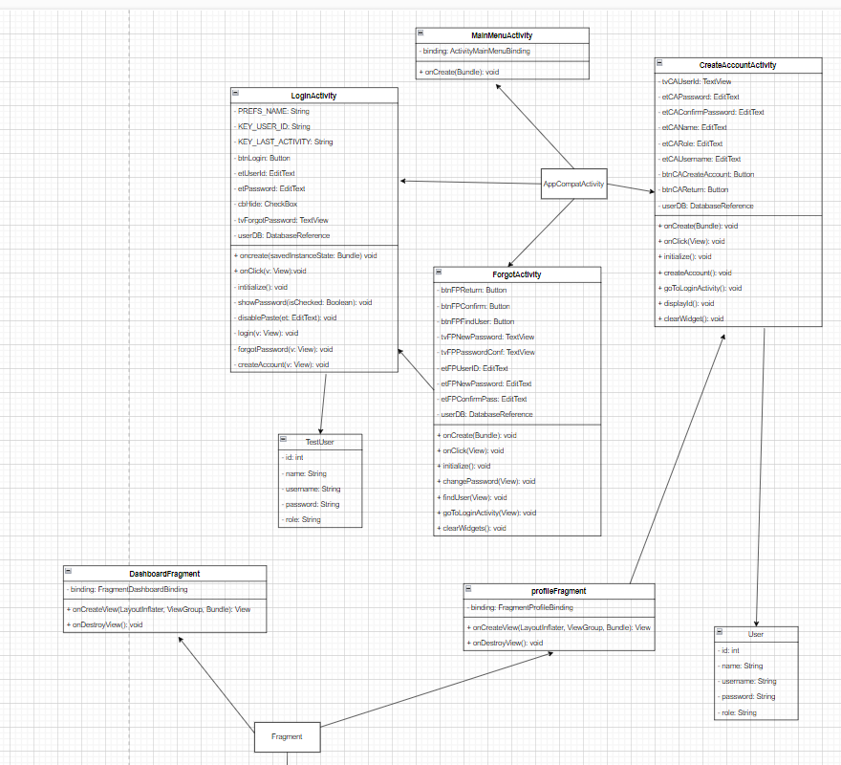
UML Diagrams

Slide 10
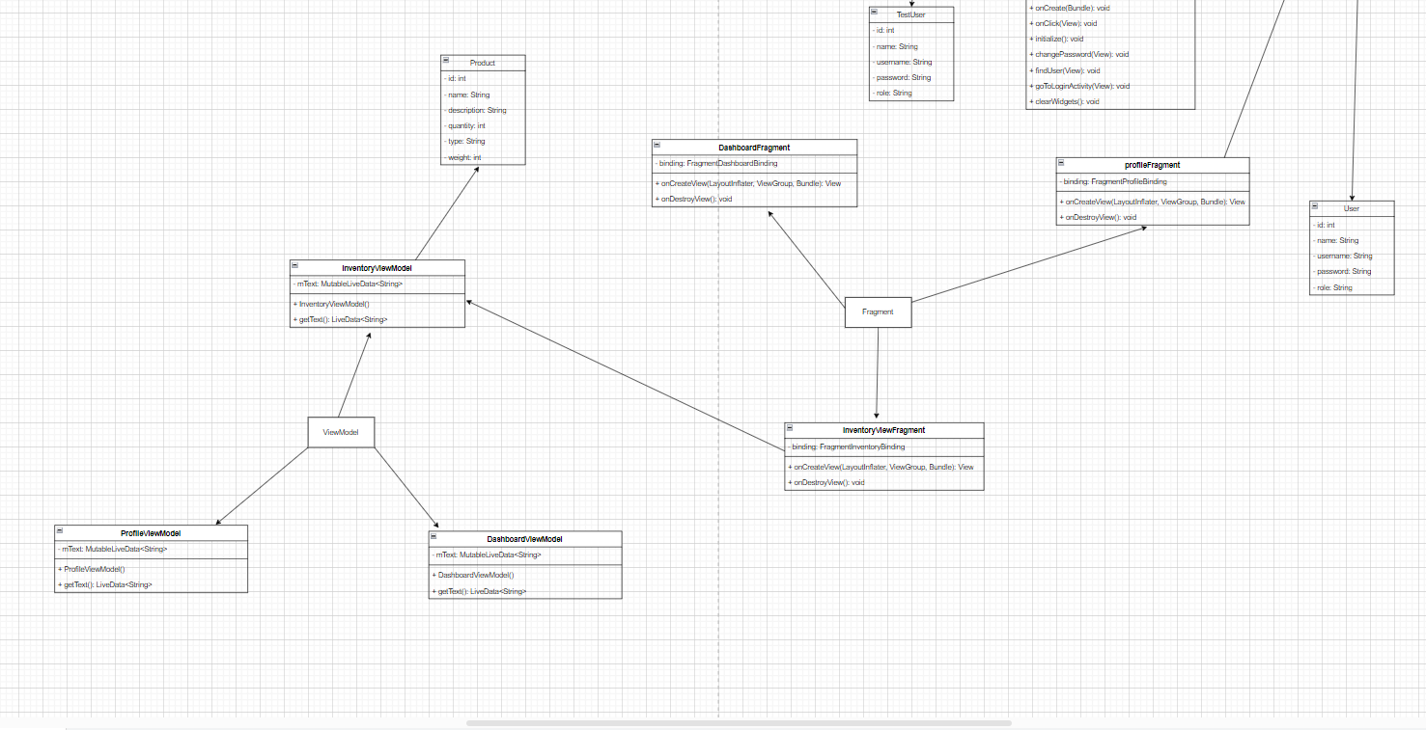
UML Diagrams

Slide 11
Design Patterns
• Singleton for Database Handling.
• MVC Architecture for App Structure.
• Factory
• Builder

Slide 12
Conclusion
• Comprehensive inventory system with role-based access.
• Firebase for real-time updates and authentication.
• Efficient product management & order processing.
• Future scope: More automation & AI-based analytics.

